Slide 1
Willow Street Time Capsule
Introduction
Standards
Task
Process (1) (2) (3) (4) (5) (6)
Evaluation
Conclusion

Slide 2
Introduction
How will you remember high school?
It’s official! Your class will be the last class to attend Willow Street Academy. This means that only two classes EVER attended this school. Although the stay at Willow Street was a short one, it needs to be remembered accurately.
Who better to document the memories at Willow Street Academy than YOU?

Slide 3
Standards
PA Academic
ITSE
1.2 Students read, understand, and respond to informational text.
1.4 Students write for different purposes and audiences.
1.8 Students gather information from a variety of sources, analyzing and evaluating the quality of information they obtain to answer research questions.
1.9 Students use technology to locate, evaluate, and collect information from a variety of sources for a variety of purposes.
1.B Students create original works as a means of personal or group expression.
2.B Students communicate information and ideas effectively to multiple audiences using a variety of media and formats.
3.C Students evaluate and select information sources and digital tools based on the appropriateness to specific tasks

Slide 4
Task
You will have 2 days to compile various items that represent you, your community, and your VERY unique high school experience.
You will be required to research information on current global and local events, entertainment, culture, any other information you see to be of importance to today’s society.
Possible references are listed on the following slide.

Slide 5
Sources
Process (pg. 1)
Answer the following questions. Use a separate sheet of paper to record your answers.
Who won the World Series this year?
Who won the Super Bowl this year?
What was the top grossing movie of this year?
What were the best selling fiction and non-fiction books this year?
http://www.yahoo.com/
http://www.eonline.com/
http://imdb.com/
http://www.sportingnews.com/

Slide 6
Sources
Process (pg.2)
Topic- Local
· Who is the Principal of your school?
· Who is your guidance counselor?
· What is the name of your librarian?
· Who is the Mayor of Lebanon?
http://www.lebanonpa.org/
http://www.lebanon.k12.pa.us

Slide 7
Sources
Process (pg. 3)
· List at least two major events that have changed your community.
· List at least two major events in pop culture.
http://www.nytimes.com/
http://www.washingtonpost.com/
http://www.onlinenewspapers.com/
http://www.cnn.com/

Slide 8
Process (pg. 4)
Find what the price was for the following 5 items in the year 2010. List the price and the website where you found the information.
1. A gallon of milk
2. A pair of jeans
3. A gallon of gas
4. A Big Mac meal from McDonalds
5. A loaf of bread

Slide 9
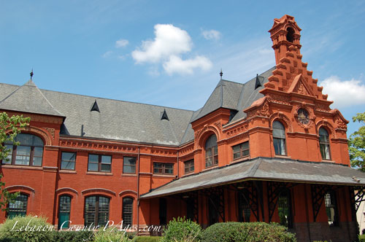
Process (pg. 5)
Find the 10 richest people in the world.
Explain what the Newberry Medal is and which books have received this prestigious honor in the last 5 years?
Find out what the average income is for a high school dropout.
Find out what the average income is for a high school graduate.
Find out what the average income is for a college graduate.
Go to http://www.endangeredspecie.com/ and define what an endangered specie is and list 10 endangered animals and 10 endangered plants in the state of Pennsylvania.

Slide 10
Process (pg. 6)
1.Find one thing that you think will be more valuable in ten years. You must support your reasoning as to why you think it will be more valuable.
2.List three goals that you would like to accomplish in the next four years.
3. Write a letter to yourself that will be read on graduation day. Your paper should focus on goals for the future and how you hope to succeed. Your paper also needs to contain a daily diary or what a typical day is like for you. The framing idea for your paper should be “Where are you now and where do you think you will be in 4 years?”

Slide 11
Evaluation
 | BEGINNING (1) | DEVELOPING (2) | ACCOMPLISHED (3) | EXEMPLARY (4)
TIME CAPSULE CONTENTS | You answer fewer than half the questions and you fail to compose any essays. | You answer all the questions but your essays are brief and unorganized. | You answer all the questions and your essays meet length requirements but they still lack complete cohesion. | You answer all the questions and your essays are thoughtful and complete.
WORKING IN GROUP | You put no effort into participating or finding information. | You participated, but little effort was put into finding quality information. | You showed effort to participate but did not do an equal amount of work as other group members. | An equal amount of work was completed, and quality work was produced.
Total

Slide 12
Conclusion
Think of how much your own life has already changed and many of you are under fourteen years of age. What will people think of you or your life 100 years from now? How will you remember yourself even five years from now? This is your chance to put your own stamp on your community, and your world for future generations. Make sure this time capsule SCREAMS ‘you’ and what you find important to pass on to future generations!

