Slide 1

Elementary Resources
Online Literacy Resources
Notes:
As a librarian I found that a struggle wasn’t so much finding texts, but finding appropriate texts to match to a reader. This was particularly the case for nonfiction because of how different nonfiction is composed (background knowledge, content vocabulary, and many other things come into play). There are fiction books across the continuum on every subject, but not so much with nonfiction. It is very difficult to find books on chemistry at a 4th grade reading level with the components of chemistry that are studied at the high school level. Its very important to examine your resources available to you outside of the walls of the school.
Schools are relying more and more on technology as a means to access texts, so this power point will show you a few websites to access when seeking texts (both fiction and nonfiction)
In addition to listing the popular resources, I tried to list a few that some of you may not be aware of, including some interactive websites you can use with your students.

Slide 2

http://www.storylineonline.net/
Popular children’s stories read aloud by members of the Screen Actors Guild.
Features sound effects, moving and still images, and exceptional story-tellers!
Great for use on iPads for individual students, or for whole-group using interactive whiteboards.
Notes:
Also known as “Book Pals”. Stories are read by actors from the Screen Actors Guild (excellent storytellers) with light animation. Read popular stories (Stella Luna, Rainbow Fish)

Slide 3

Read kiddo read
James Patterson’s website
Organized by ages (0-8, 6 and up, 8 and up, and 10 and up)
Educator portal with lots of lesson plans aligned to popular books.
www.readkiddoread.com
Notes:
Website from popular author James Patterson. Was created out of a drive to encourage reluctant readers to read. Lots of recommendations.

Slide 4

literactive
Commonly listed as an alternative to Starfall.
Preschool-Grade 1
Materials for Guided Reading
ePoetry
ePicture Books
Companion print materials available
Notes:
I chose to list this website because it often came up as an alternative to Starfall. Very similar in components/activities offered. Not as “pretty”. Includes poetry activities and picture book activities. Offers companion print materials (some for purchase).

Slide 5

International Children’s Digital Library
http://en.childrenslibrary.org/
Over 4,400 books available in 55 different languages.’
ESOL students
For individual use on iPads or group instruction using interactive whiteboards.
Notes:
I had learned about this website in college and was very surprised to hear that more people were not aware of it.
Large amounts of books in multiple languages (so class can read same book in multiple languages). Not the most “popular” books, but high quality illustrations. Interactive page turning.

Slide 6

Starfall
http://www.starfall.com/
Reading with phonics
Phonemic awareness
English language development (ESOL)
Apps are available for iPads
Also, check out the “Top 5 Alternatives to Starfall” at http://www.educational-freeware.com/news/best-literacy-websites.aspx
Notes:
Had to include – too popular. Mainly wanted to point out Apps available for apple.
Despite this is a room of Reading Specialists, this website is highly recommended to ESOL teachers.
Found this website “Top 5 Alternatives…”

Slide 7

Reading Planet
http://www.rif.org/kids/readingplanet.htm
Reading is Fundamental (RIF) is the largest children’s literacy nonprofit in the United States.
Features ebooks, writing station, reading games, and activity lab.
Students can illustrate a story after reading the words, create a bookplate, and write poetry.
Also features several teacher resources.
Notes:
Wealth of information surrounding literacy.
Lots of interactives.
Articles.
Similar to Reading Rockets, but certainly not a substitute.

Slide 8

Reading Rockets
Extensive amount of information regarding literacy skills for
  Teachers
    FAQs
  Parents
  Principals
  Librarians
http://www.readingrockets.org/
Notes:
Very common website – want to draw attention to the Frequently Asked Questions page. Great to prepare yourself for the questions parents will ask regarding their student(s). FAQ’s on Policy, Assessment & Evaluation, Motivation,
Ex: I’m raising my child to be bilingual? What can I do to make them strong readers in both languages? Provide links, articles, and recommended strategies.

Slide 9

Secondary Resources
Online Literacy Resources

Slide 10

Internet Public Library a+ Writing
Excellent starting point for students writing research papers.
Includes information on gathering information, developing a thesis, and writing a paper.
Includes a section with additional links on research and writing.
http://ipl2.org/div/aplus/
Notes:
Wealth of information. In 2010, the Internet Public Library and the Librarians Internet Index merged creating IPL2. Always one of my starting points when searching the web. Also a subdivision for Kids and Teens. This website “A+ Writing” is go to website for writing instruction/review.

Slide 11

Adlit.org
Similar to Reading Rockets for students in grades 4-12.
Information for teachers, parents, and students.
Printable graphic organizers for vocabulary, comprehension, and writing.
Notes:
Sister site to Reading Rockets. “Research and Reports” – great website for advocacy. (Parents, Administrators, etc.)

Slide 12
Online ebooks
http://educhoices.org/articles/Online_Libraries_-_25_Places_to_Read_Free_Books_Online.html
Pathfinder of links to “school friendly” ebooks.
Notes:
Instead of listing various ebook websites (as many of them include the same books from the Public Domain) this website includes a list of 25 “educational friendly” ebooks.

Slide 13

Books should be free
Audiobooks from the Public Domain
Mostly classic titles
Organized by genre
http://www.booksshouldbefree.com/
Notes:
Website for audiobooks as well as links to other websites that offer audiobooks.

Slide 14

Various Literacy Websites
Nearly 100 links to literacy websites.
Aimed at middle school students.
Links on vocabulary, poetry, bibliographic styles, and grammar.
http://www.internet4classrooms.com/lang_mid.htm
Notes:
Depository of websites surrounding literacy.

Slide 15

Free reading
http://www.freereading.net
K-4 students
Includes activities, lesson plans, and downloads to teach early readers.
Download decodable texts
Notes:
Open-source, free reading intervention program for students in grades K-4. Lots of downloads, lesson plans, activities, decodable texts,

Slide 16

Young Adult Library Services Assn.
Provides recommendations for nonfiction and fictional books.
Ways to motivate reluctant readers.
www.ala.org/yalsa
Notes:
Division of the American Library Association. Lots of book lists as a starting point for popular books. Organized by age group/genre. “Books for Boys”, “Books for Girls”

Slide 17

Google Literacy
http://www.google.com/literacy/
Includes links to books, articles, and videos on literacy.
Several links to worldwide literacy initiatives.
Notes:
Search portal to all things literacy. Narrows your google search to include things only surrounding literacy. Search worldwide (Reading Rockets equivalent in Australia) actually includes a lot of great downloads.

Slide 18
Web 2.0 interactives

Slide 19

Piclit
Choose a picture from the gallery, and add text. Word choices are available or use your own. There is also an introduction to writing poetry using this tool.
www.piclits.com
Notes:
Great tool for using vocabulary, adjectives,

Slide 20

zoobursts
Digital storytelling tool that lets anyone easily create his or her own 3D pop-up books.
Includes built-in database of 10,000 free images and materials.
Can use own voice to record.
Notes:
Make a 3D popup book (3d meaning you can view it from all angles)
If you have webcam capability you can enter what they call “Augmented Reality” similar to a xbox kinect where you can wave your hand and it will turn the page.
Can highlight characters to speak.

Slide 21

PBS Whiteboard
http://pbskids.org/whiteboard/
Listening
Reading Comprehension
Synonyms/Antonyms
Can be used as an extension activity for students who have mastered the current lesson, or for students who need additional instruction.
Notes:
Compilation of interactive whiteboard activities about listening, reading comprehension, and others.

Slide 22
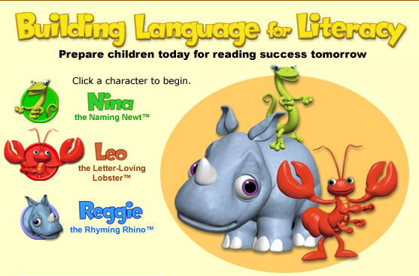
Building Language for Literacy
Oral language development
Phonemic awareness
Sorting
Word Recognition
Phonics
http://teacher.scholastic.com/activities/bll/
Notes:
Choose a character and play “games” requiring students to categorize, spell, identify rhyming words, among others.

Slide 23
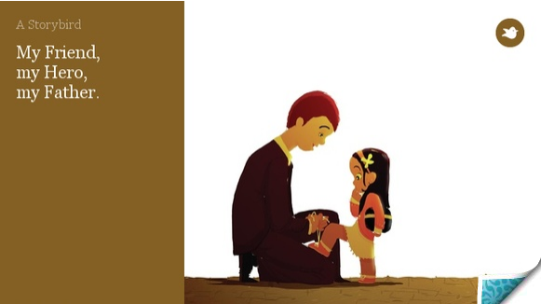
storybird
www.storybird.com
Collaborative storytelling
Students can create stories and real artists can upload their illustrations.
Teachers can make class accounts without needed individual student email addresses
Notes:
Similar concept to Zoobursts in that you’re creating a story from a picture, but all of the art is uploaded from freelance artists (beautiful artwork).

